Slide 1


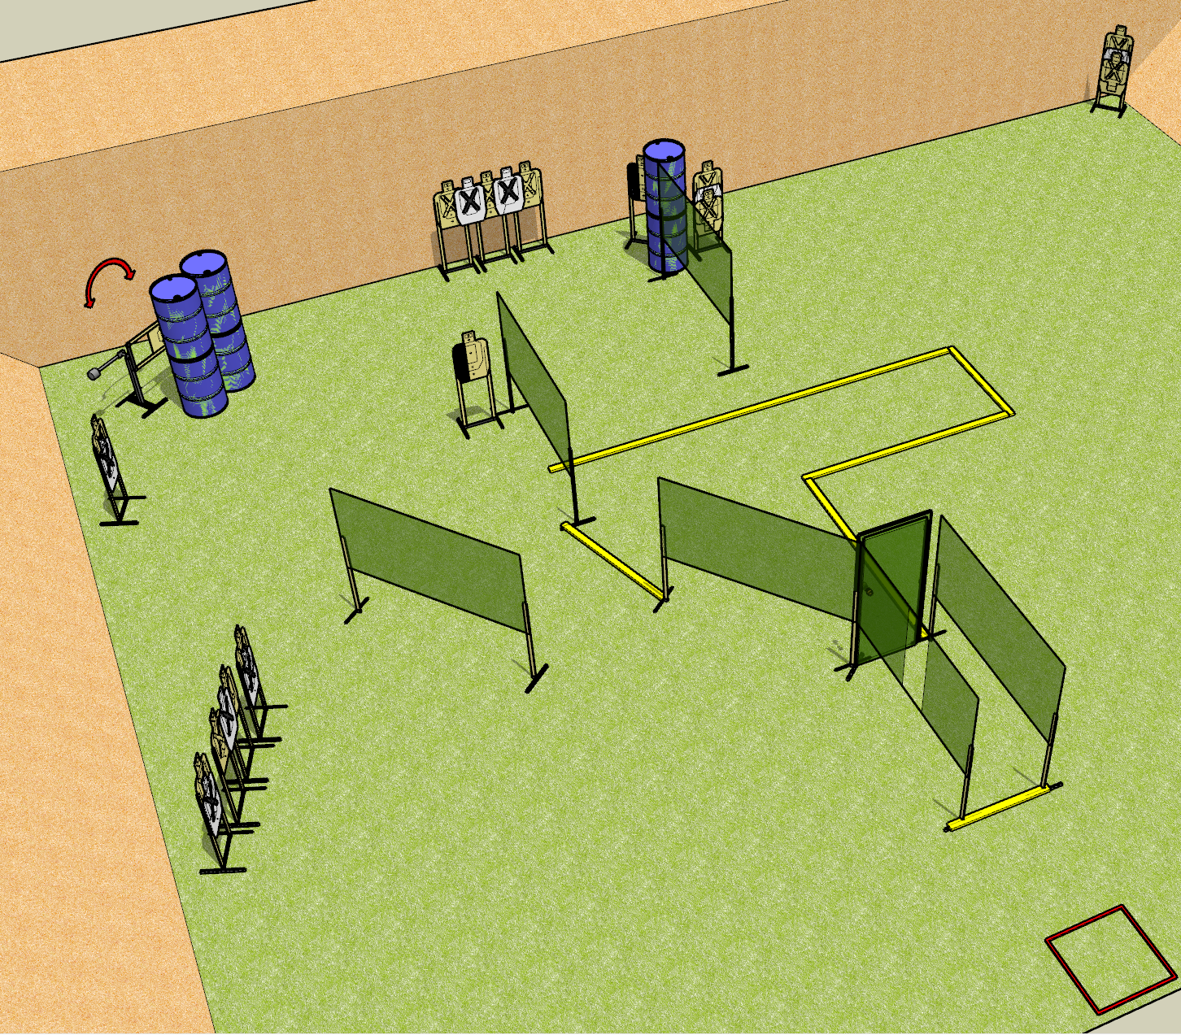
 | Dothan Gun Club – USPSA Match Partial City Course Designer : Drew Coleman
START POSITION : Standing in start box, not touching the box.
GUN READY CONDITION : Pistol loaded and holstered. PCC stock on belt, safety on, pointed at the door |  | SCORING: Comstock, 30 rounds TARGETS: 15 paper, 0 Steel SCORED HITS: Best 2 on paper, steel until down START-STOP: Audible, last shot RULES: The start box is not part of the shooting area.
STAGE PROCEDURE: Engage targets as they become available from within the fault lines

